Slide 1



DeepSentiment:
Tweet Sentiment Analysis using BERT-based models & LLMs
By Carl May and Dhyey Mavani

Slide 2
Introduction
Tweets are seems to have at least some predictive power and influence in the financial markets and our world!
Goal: Analyze predictive accuracy of BERT-based models, and LLM-based deep learning methods in the task of predicting sentiment of tweets.

Slide 3
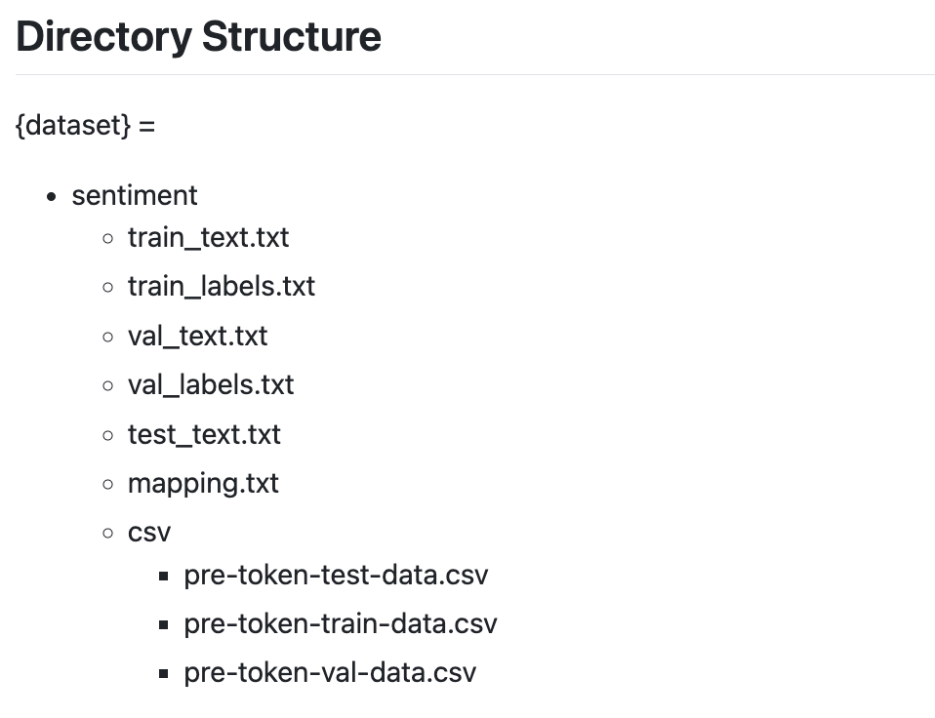
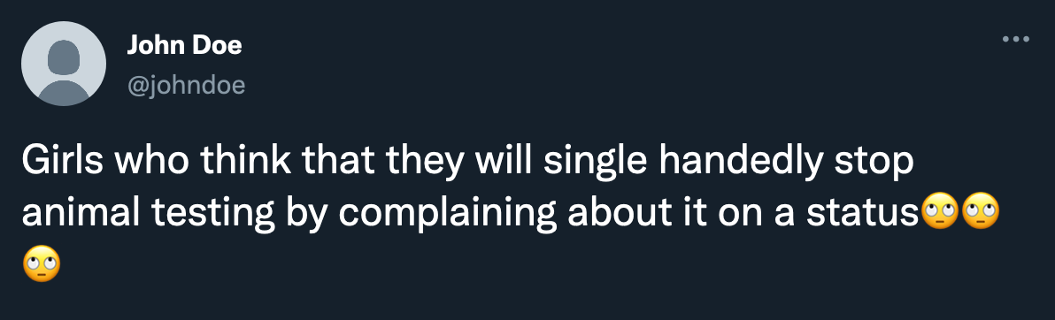
Data & Preprocessing
Our dataset comprises tweets extracted from the TweetEval benchmark, specifically focusing on the sentiment subset.
Training data: 45615 tweets
Validation data: 2000 tweets
Testing data: 12284 tweets
Preprocessing:
Removing special characters
& unnecessary words
Expanding contractions
0 → Negative
1 → Neutral
2 → Positive
girl think singl handedli stop anim test complain statu

Slide 4
Models
naive-bayes
bert-base-uncased
roberta-base
phi-3 mini (few shot)
Transformers, Transformers everywhere!

Slide 5
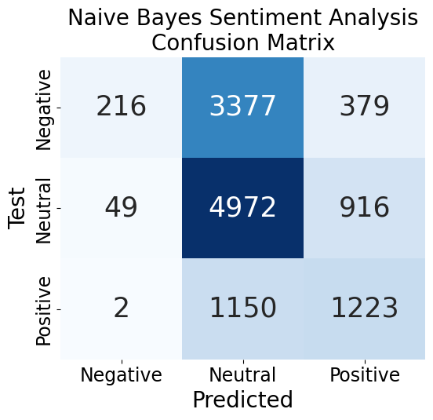
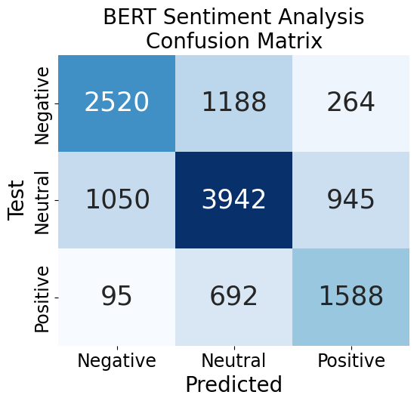
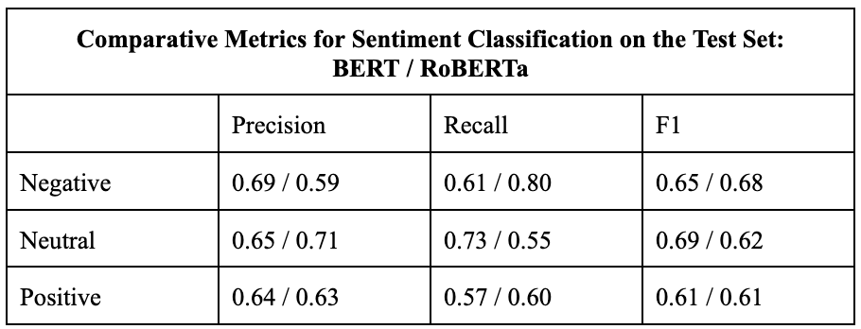
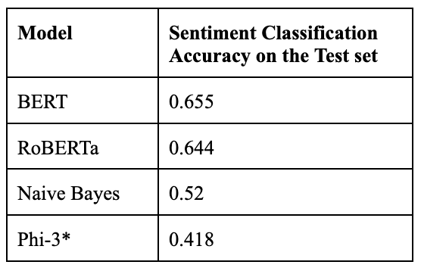
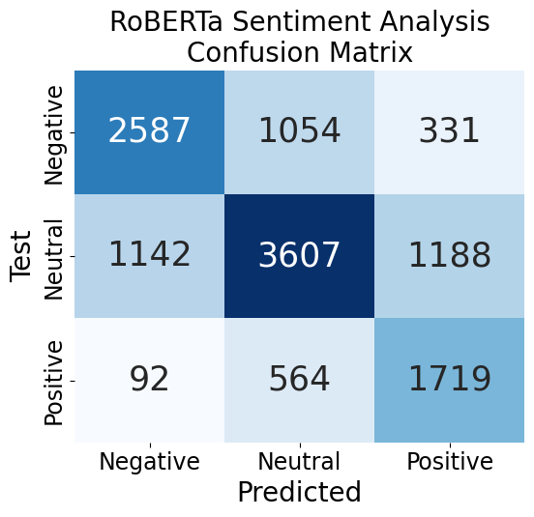
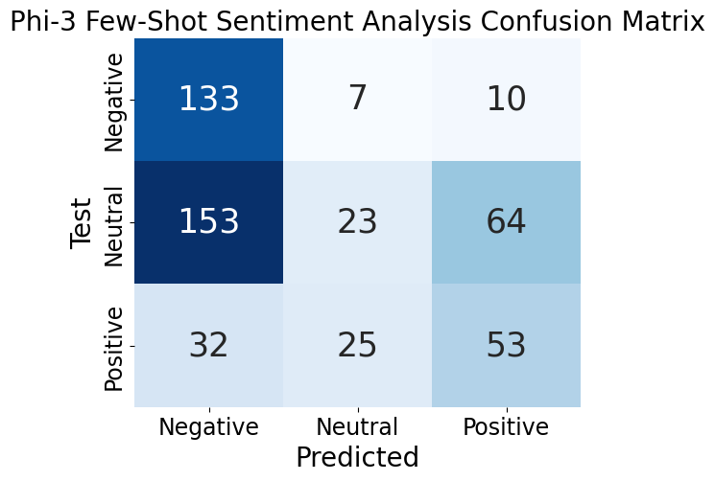
Results & Analysis

Slide 6

References
Future Work
[1] TweetEval Benchmark and Associated Papers: https://github.com/cardiffnlp/tweeteval
[2] BERTweet Paper: https://paperswithcode.com/paper/bertweet-a-pre-trained-language-model-for
[3] Hugging Face's FacebookAI/RoBERTa-base Model: https://huggingface.co/FacebookAI/roberta-base
[4] V. Mahalakshmi, P. Shenbagavalli, S. Raguvaran, V. Rajakumareswaran, E. Sivaraman, Twitter sentiment analysis using conditional generative adversarial network, International Journal of Cognitive Computing in Engineering, Volume 5, 2024, Pages 161-169, ISSN 2666-3074, https://doi.org/10.1016/j.ijcce.2024.03.002.
[5] Hugging Face’s Microsoft/Phi-3-mini-128k-instruct : https://huggingface.co/microsoft/Phi-3-mini-128k-instruct
Exploring the comparative efficacy of zero/one/few-shot learning and different LLMs
Fine tuning some other hyperparameters using a more powerful & efficient compute resource
Having a multi-agent LLM framework with an orchestrator and some specialised agents to better suit our task
Using Generative Adversarial Networks (GANs) to predict tweet sentiments

